Slide 1
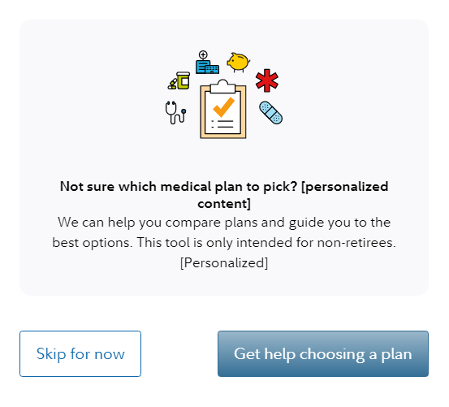
Decision Support Tool screenshots
Entry point from client NetBenefits® page:
Screenshot for illustrative purposes only.

Slide 2
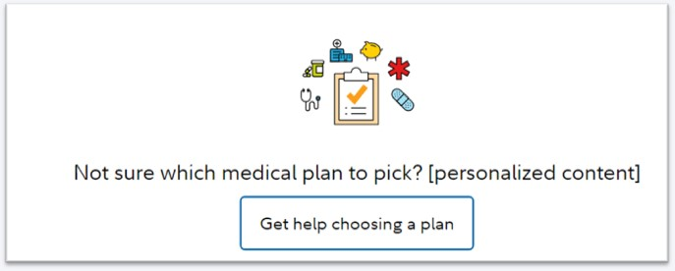
Decision Support Tool screenshots
Skip for now option or Returning to review benefits:
Not sure which medical plan to pick?
Screenshot for illustrative purposes only.

Slide 3
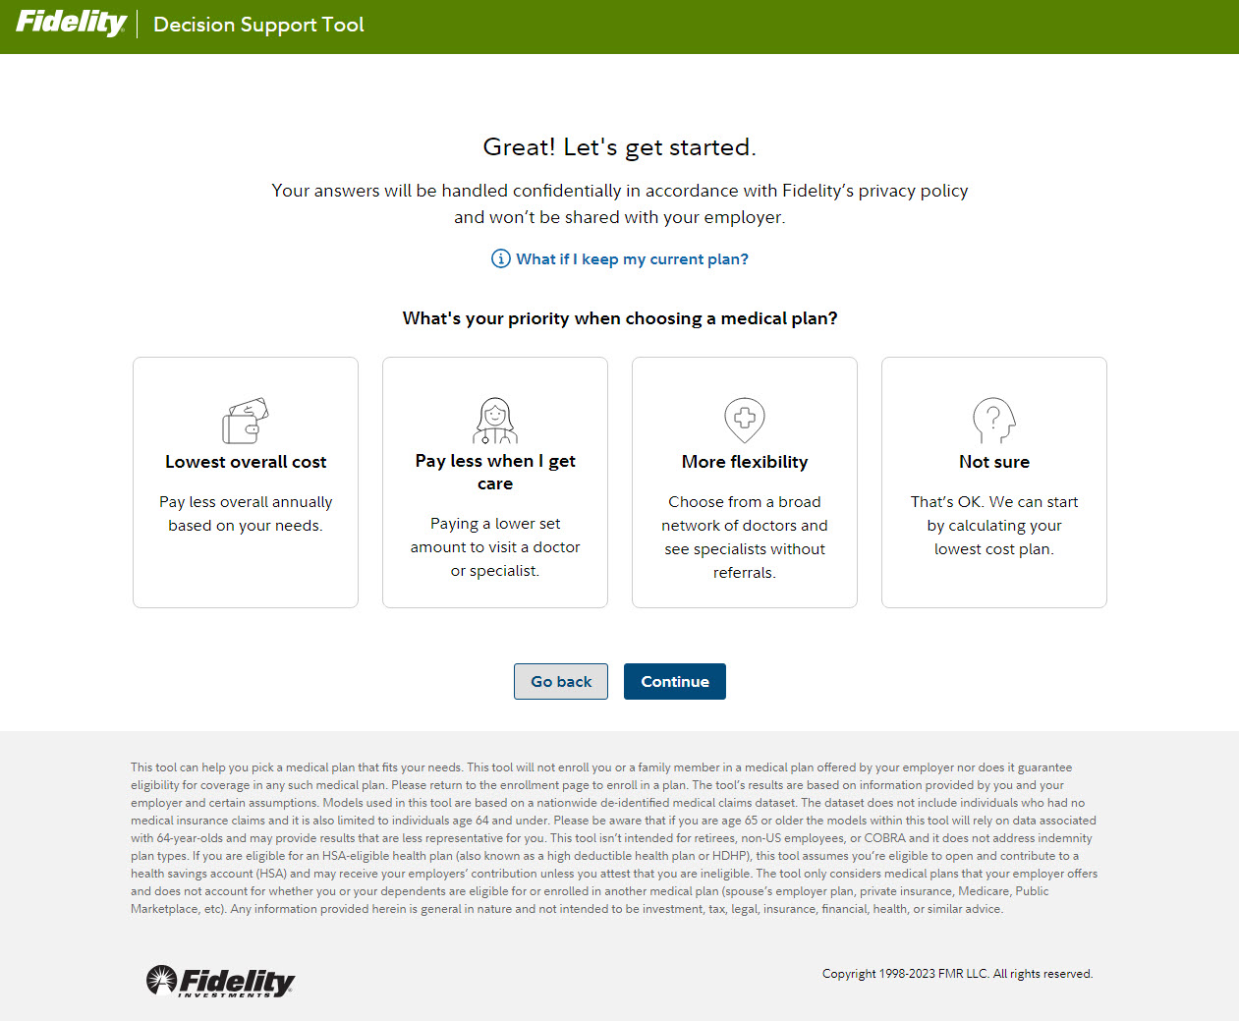
Decision Support Tool screenshots
Personal preferences page:
Screenshot for illustrative purposes only.

Slide 4
By using these communications, you represent that you are an authorized representative of the organization for which you are copying, distributing, posting or otherwise using the Fidelity prepared communications attached here and on behalf of such organization accept these terms and conditions on behalf of the organization located at http://go.fidelity.com/TermsForClientUsage
For plan sponsor use only.
Fidelity Workplace Services LLC, 245 Summer Street, Boston, MA 02210
© 2022 FMR LLC. All rights reserved.
1041970.1.0

