Slide 1



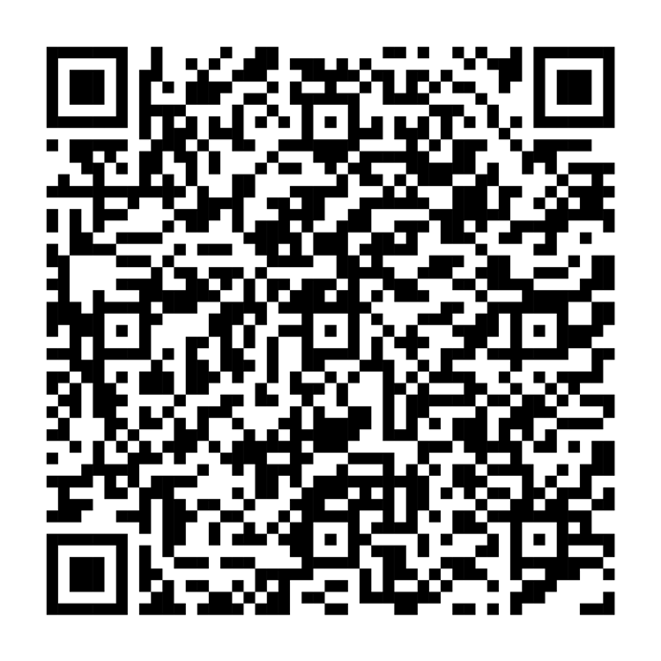




A financial resource created for military veterans and their families
Visit our Military Community Zone for insights and information to help prepare for the financial opportunities of life after military service.
Scan the code to get started, or visit Fidelity.com/military.
Fidelity Brokerage Services LLC, Member NYSE, SIPC, 900 Salem Street, Smithfield, RI 02917 The Fidelity Investments logo is a registered service mark of FMR LLC.
© 2024 FMR LLC. All rights reserved.
1165793.1.0

