Slide 1


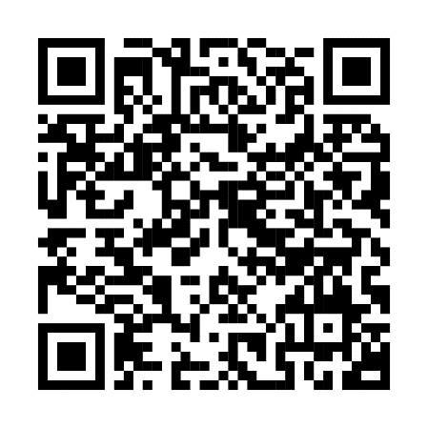
Build a future
that’s true to you
As we celebrate Pride, we acknowledge that when it comes to money, everyone has unique needs.
Scan the code or visit
Fidelity.com/lgbtqplus
to learn more.
Investing involves risk, including risk of loss.
Fidelity and the Fidelity Investments logo are registered service marks of FMR LLC.
Fidelity Brokerage Services LLC, Member NYSE, SIPC, 900 Salem Street, Smithfield, RI 02917
© 2024 FMR LLC. All rights reserved. 1143859.1.0

