Slide 1



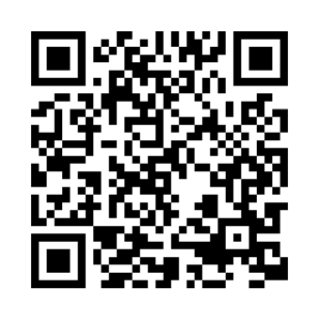
Financial Wellness Month
Make money progress. Find your possible.
Make every dollar count this year. Find hands-on tools, workshops, and articles to help with everything from tackling debt and saving for the unexpected to reaching your retirement goals.
SCAN to get started. Hover your phone’s camera over the code. No app needed.
NetBenefits.com/MyFinancialWellness
Fidelity Brokerage Services LLC, Member NYSE, SIPC
© 2024 FMR LLC. All rights reserved. 1169643.1.0

