Slide 1


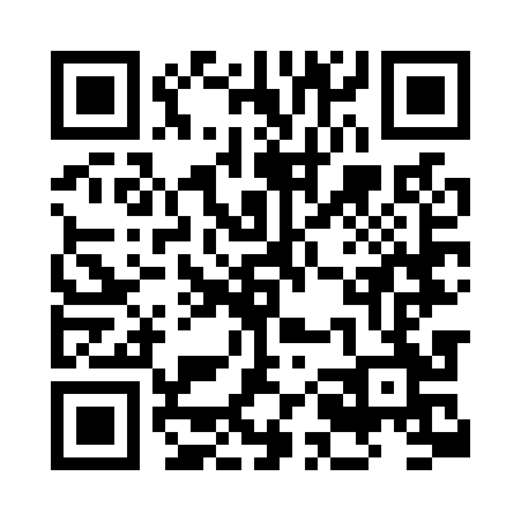
Financial Wellness Month
Make money progress. Find your possible.
Make every dollar count this year. Find hands-on tools, workshops, and articles to help with everything from tackling debt and saving for the unexpected to reaching your retirement goals.
NetBenefits.com/MyFinancialWellness
SCAN to get started. Hover your phone’s camera over the code. No app needed.
Fidelity Brokerage Services LLC, Member NYSE, SIPC © 2024 FMR LLC. All rights reserved. 1169645.1.0

