Slide 1


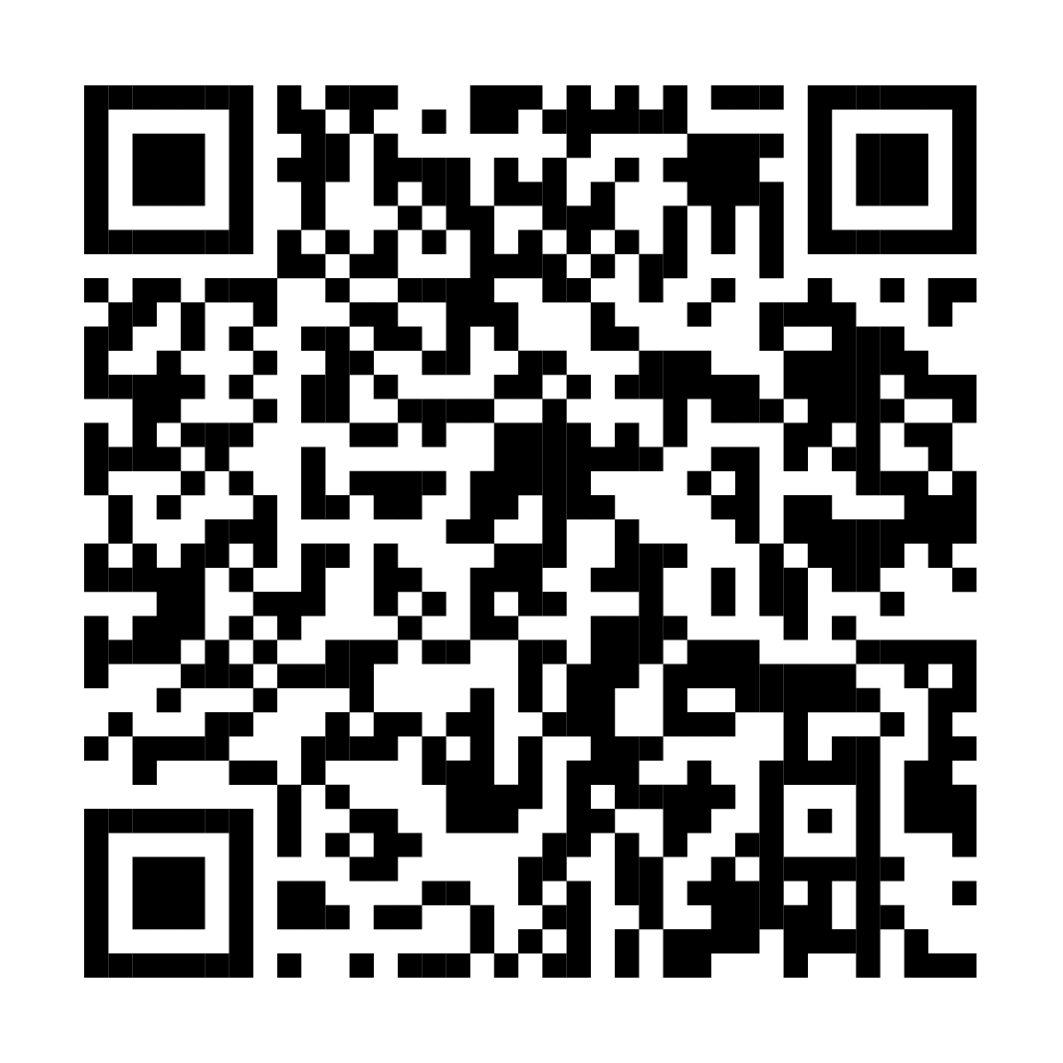
Feel better about the cost of
health care with an HSA
This annual enrollment, choose our [name of HSA-eligible health plan]
and open a Fidelity Health Savings Account (HSA). Together they can help you save money on taxes*, the funds never expire, and you can spend your HSA
money now or invest it for the future.
Scan this code or visit
Fidelity.com/HSA for more info.
* With respect to federal taxation only. Contributions, investment earnings, and distributions may or may not be subject to state taxation. See your tax professional for more information on the state tax implications of HSAs.
Fidelity HSA and the Fidelity Investments logo are registered service marks of FMR LLC.
Fidelity Brokerage Services LLC, Member NYSE, SIPC, 900 Salem Street, Smithfield, RI 02917
© 2025 FMR LLC. All rights reserved.
CLIENT LOGO
1098282.4.0

